Slide 1
Beginners’ Day 2023
McKee Road Elementary AllStars
Incoming Kindergarteners for the 2023-2024 School Year

Slide 2
What you need to know…..
We are excited to welcome your child to McKee Road beginning August 2023!
CMS Online Enrollment is currently open. If you have not already done so, please submit an application at https://www.cmsk12.org/enroll.
Each child entering kindergarten must have a current health assessment and up-to-date immunizations.
Please call the school office if you have questions 980-343-3970

Slide 3
Staggered Entry in August
Kindergarten Students will follow a staggered entry schedule beginning with the first day of school on Monday, August 28th. Kindergarten students will report to school only one day during the first week of school.
Kindergarten students will report to school using the following schedule:

Slide 4
Monday, August 28: Students whose last name begins with the letters A-I.
Tuesday, August 29: Students whose last name begins with the letters J-M.
Wednesday, August 30: Students whose last name begins with the letters N-R.
Thursday, August 31: Students whose last name begins with the letters S-Z.
Friday, September 1: No Kindergarteners attend school
Please Mark Your Calendars!
* Friday, September 1: : Kindergarten teachers meet with administrators and create final rosters. If your child’s teacher changes, you will receive a call from a teacher or administrator.
* Tuesday, September 5 All kindergarten students return to school & report to their new classroom.

Slide 5
Rising Kindergarten Placement Information
To “Get to Know” your student, parents have the option to complete the Rising Kindergarten Placement Information form.
This form allows our administrators to learn a little more about your child. Please complete and submit by June 1st – a link will be posted on the McKee website: https://forms.gle/BxefZJrpCGi3Jtyf8

Slide 6
Parent Teacher Association (PTA)
Why Join?:
The more members we have, the more support the children in our school and community will receive.
What are the benefits of joining?
- The PTA benefits parents as well as our students, staff, and school. PTA functions are opportunities to meet other parents and teachers, building rapport and discussing issues that are on your mind. Joining the PTA also means you get a “VOICE and a VOTE” in helping shape the education of your child at McKee Road Elementary. Every dollar we spend is debated and voted on by the members at our meetings.
Who can join?
- The MRES PTA is an inclusive organization that is open to all adults who care about children and schools. It is made up of parents, guardians, family, friends, teachers, and even members of the community.
How do I join?
- Joining is simple! Just complete the membership form and pay your membership fee on https://mckeeroad.memberhub.com/
What do my dues pay for?
- Membership dues are split between the state and national PTA offices. In return, local PTAs and members receive access to valuable resources, information, grants, support, and training programs.
Find more information at www.NCPTA.org and http://meckpta.weebly.com/
What is a PTA:
A group of Staff and Parent Volunteers that represent and support our
school in various ways.
This includes, but is not limited to: creating and executing events for our
families throughout the year, supporting and celebrating our staff,
coordinating fundraisers, maintaining regular communication with families,
representing and advocating for our school and our students/staff/families,
and so much more!
Who is the PTA:
The PTA consists of Board of Directors:
- Principal, Vice Principal, the elected PTA Officers (President, Vice President(s), Secretary, and Treasurer), as well as Teacher Representative(s), and Chairpersons of any Standing Committees
Other PTA Members include:
- Various Special Area Committees and Parents*
*PTA dues must be paid each year to be considered a voting member
How to Join:
PTA Officers are elected by majority vote of current/valid PTA Members
and must also be current/valid PTA Members. They are also required to
be registered CMS Volunteers.
Committee Chairs, Committee Members, and other General Volunteers are able to volunteer by contacting the Board directly via email at mckeeroadpta@gmail.com (attn: PTA 2022-23).
- For detailed descriptions of Officer and Committee Positions click here.

Slide 7
Parent Teacher Association (PTA)
Some Events and Activities Hosted or Supported by the MRES PTA Team:
Monthly Spirit Nights and Meet-Ups
Monthly Coffee Chats with the Principal
Monthly Staff Treats
Monthly Spirit Wear Days
Book Fair (Fall and Spring)
Fundraisers (i.e.: Boosterthon Fun Run)
International and Cultural Heritage Night/Week
Autism Awareness Week
Staff Appreciation Week
Spirit Week
Fall Jamboree
School Dance
Family Nights
Service Projects
...and much more!
Some Helpful Info for New Parents:
Pay Student Fees, order Spirit Wear and More! https://mckeeroad.memberhub.com/
(School/PTA payments are made here)
Be sure to sign up for the Mini News (here)
The PTA uses Facebook for updates and communication
(https://www.facebook.com/groups/MRESPTA)
Link your Harris Teeter VIC Card
(https://www.harristeeter.com/together-in-education -- school code 1419)
Connect Your Amazon Account to McKee PTA’s Amazon Smile:
(Visit https://smile.amazon.com/ch/56-1665313 -- Sign in with your Amazon.com credentials -- Choose PTA North Carolina McKee Road Elementary as your charitable organization)
Download the BoxTops for Education App
Contact the MRES PTA Team any time at mckeeroadpta@gmail.com

Slide 8
Role of the School Nurse
Screens for health problems that may interfere with learning.
Consults with school regarding health and safety issues.
Helps manage children with chronic medical conditions.
Provides referrals to community resources.

Slide 9
Immunizations
All children attending school in North Carolina must complete a series of immunizations.
North Carolina law requires all principals to exclude children from school who have not completed this series within 30 days of enrollment.
The immunization record must be brought to school when the child is enrolled.

Slide 10

Need Immunizations/Shots?
Available at your doctor’s office or clinic and at both Health Department locations.
Call 704-336-6500 for a Health Department appointment.
Bring immunization record to appointment.

Slide 11
Kindergarten Health Assessment
NC law requires all first-time Kindergarten and Pre-K students to have a physical exam.
The exam must be done no more than 12 months prior to the date of school entry.
Schedule NOW if not already completed.
No Doctor? Ask your School Nurse.

Slide 12
Medications
The school does NOT provide medications for students.
It is best for the student to take medications at home. This eliminates class disruption and loss of learning time.

Slide 13
Medications
If medications are needed at school…
A medication authorization form must be filled out by the doctor and parent. This is required for all medications, including over-the-counter medications such as Tylenol, cough syrups, and ointments.
The parent is to provide medications and refills. All medications must be in their original containers.

Slide 14
Illness at School
Schools are limited in their ability to care for your sick child.
Your child will need to go home if sick at school (vomiting, fever, injuries and infections.)
Please provide emergency phone numbers to school and update as numbers change

Slide 15
Chronic Illnesses
If your child requires medications or procedures at school, please notify the school nurse or staff now so planning can begin.
Examples: Diabetes, Asthma, Severe Allergies, Seizures, or Dietary restrictions.

Slide 16
Healthy Kids Learn Better
Begin every day with BREAKFAST!!!!!
Promote good sleeping habits.
Provide an opportunity for play and exercise.

Slide 17
Introduction from Ms. Miller
K-2 Counselor

Slide 18

After School Enrichment Program at
McKee Road (ASEP)
The After School Enrichment Program provides a warm, caring environment beyond school hours where students have the opportunity to play with school friends and get their homework out of the way before the family sits down to dinner. ASEP offers exciting activities, including sports, art activities and computer exploration, which stimulate children to be healthier and happier.
Besides academic support, the ASEP program focuses on social skills development. Program leaders are respectful and positive toward children, mindful of the importance of appropriate role models. Students are encouraged to develop friendships with schoolmates that for some will last many years.

Slide 19

Lauren Sifford
ASEP Coordinator McKee Road
980-343-3970
laurenf.sifford@cms.k12.nc.us
For 2023-2024 fees and more information about the Afterschool Enrichment Program visit the CMS website, click on Departments, and then ASEP. Or call the ASEP office at 980-343-5567 or email at asep@cms.k12.nc.us
******ASEP operates from school dismissal until 6:00PM.******

Slide 20

Who are Multilingual Learners at McKee Road Elementary?

Slide 21
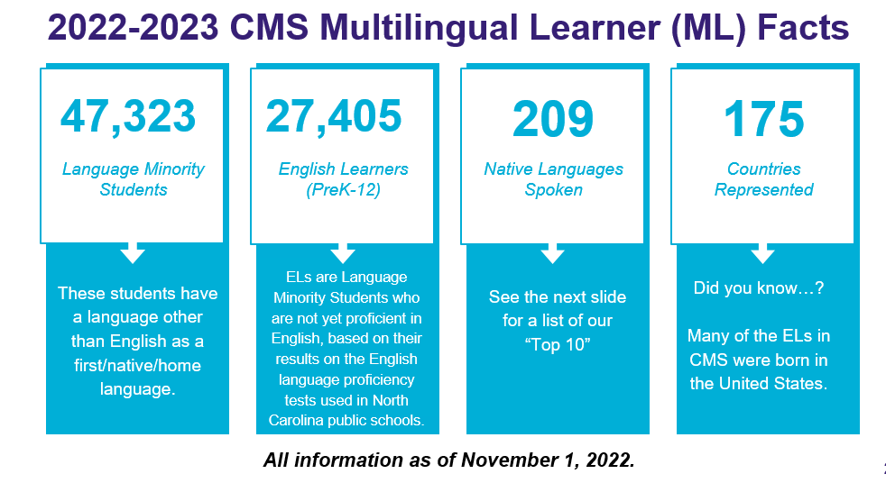
Notes:
We used screen shots to get google slides from district into powerpoint

Slide 22
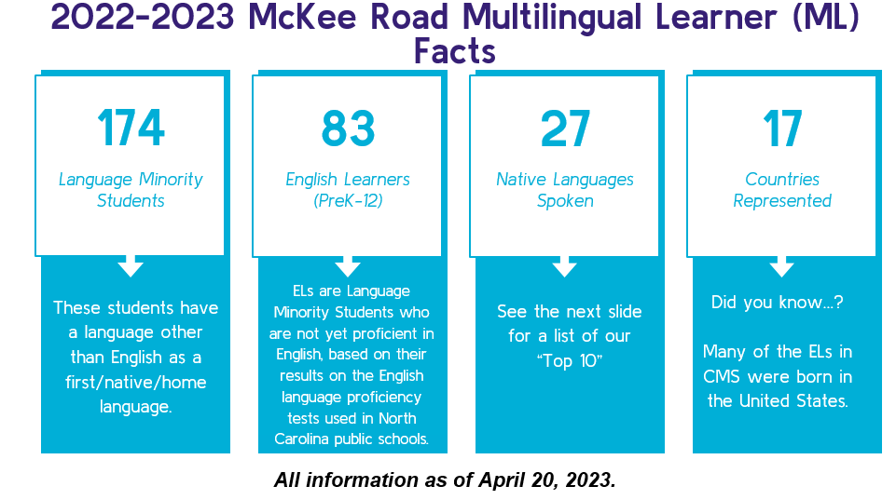

Slide 23
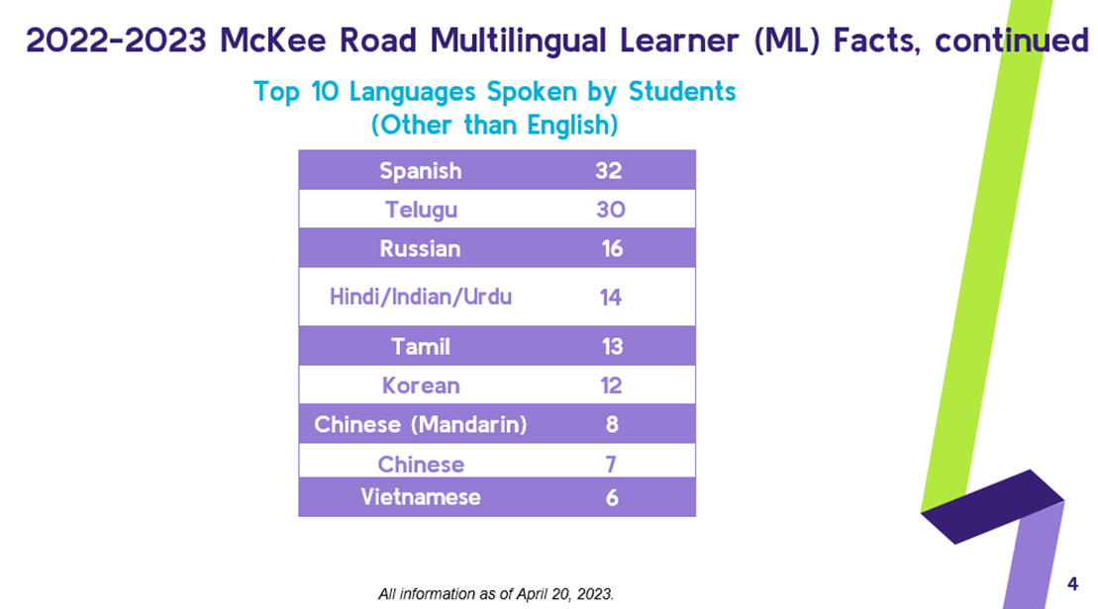

Slide 24
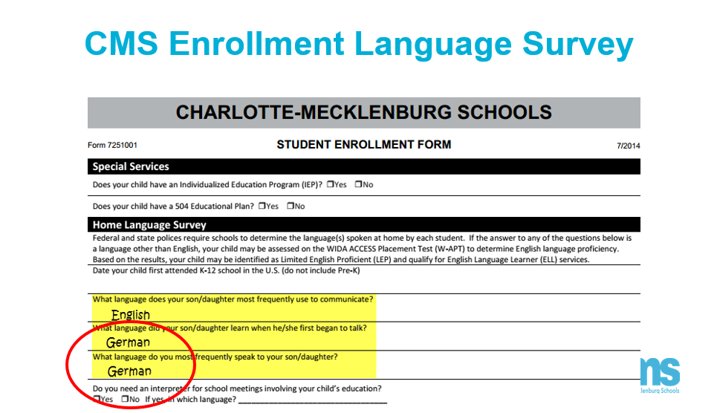

Slide 25
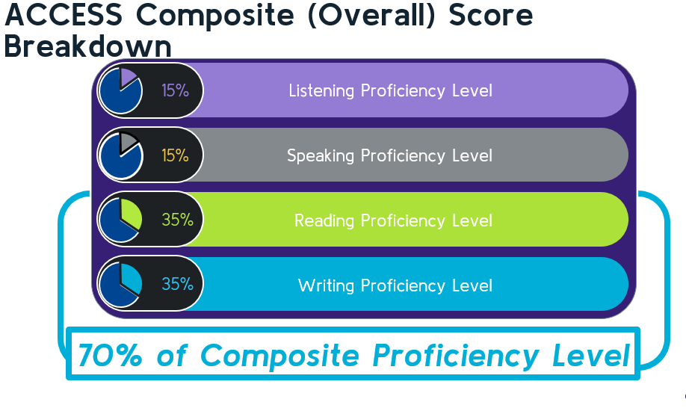

Slide 26
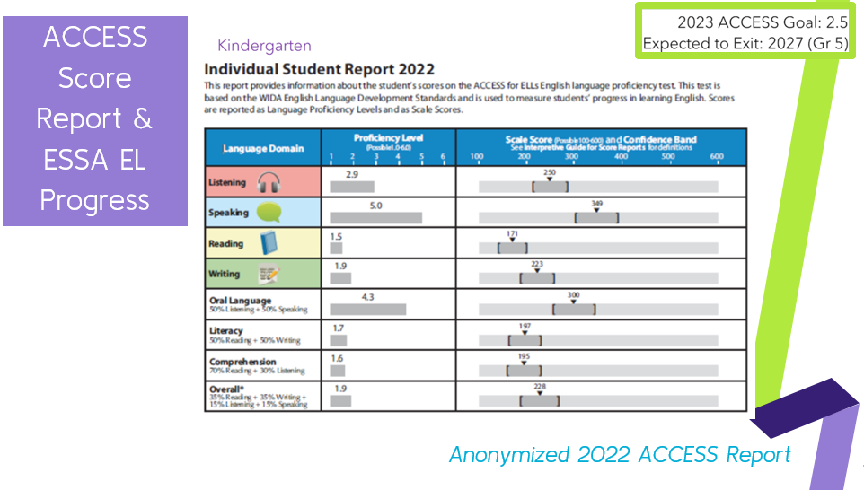

Slide 27
Attendance – Excused Absences
Per the CMS Student handbook, absences are only considered excused due to illness, medical appointments, death in the family, quarantine, court proceedings, approved educational opportunity (form 5123.21 must be completed PRIOR to absence) or religious observance.
McKee MUST receive a note for every day the child is absent to excuse the absence. ALL absences are UNEXCUSED until written documentation is received by the attendance secretary.
  Documentation can be an reporting an absence through the Mckee Road website – www.cmsk12.org/mckeeroades OR an email to the attendance secretary at laurene.simmons@cms.k12.nc.us
ONLY 10 PARENT NOTES FOR ILLNESS WILL BE ACCEPTED PER YEAR. After 10 Parent Notes, only a doctor’s/dentist’s note can excuse an absence/tardy.

Slide 28
Attendance – Unexcused Absences
Per the CMS Student Parent Handbook, traffic, oversleeping, leisure travel/family vacations, family emergencies, car trouble, bad weather, etc. are unexcused absences.
Only the principal/attendance secretary can approve absences.
Letters will be sent to parents at the 3, 6, and 10 day marks of unexcused absences.
Under NC truancy laws, the parent of any child with more than 10 unexcused absences may be prosecuted.
Please see the Student Parent Handbook at https://www.cmsk12.org for full clarification

Slide 29
Tardy/Early Dismissals
Drop off begins at 7:15, and the 7:45 start bell (aka tardy bell) rings at 7:45.
Students must be in class a MINIMUM of 210 minutes to count as present for the day.
EARLY DISMISSAL ENDS AT 2:00 SHARP. AFTERWARDS FAMILIES WILL BE DIRECTED TO THE CAR LINE.
ALL tardy check in’s/out’s that note “appointment” for the reason MUST submit a doctor/dentist note to be excused.

Slide 30
Transportation - Bus
CMS Transportation assigns buses and develops routes on an annual basis. Transportation communicates bus assignments to McKee at the start of the year.
A bus stop can be requested at any time of year, but to guarantee your child has a bus on the first day of school, you must complete the transportation “Intent to Ride” survey May 21st: https://wearecms.iad1.qualtrics.com/jfe/form/SV_cCig61mfSyNEJkG
Bus Drivers have rosters for each stop and will only allow assigned children onto the bus.
The district does use the “Here Comes the Bus” app to update parents about the location of the bus along the route.

Slide 31
Transportation – Car Line
McKee does have a car pool line for morning drop off and afternoon pick up.
If you plan on using the afternoon car line at ANY time during the year, you will need to pick up a car tag during open house in August. The car tag has a unique number to your family.
Our school uses software to enter the numbers, which then alerts the student’s teacher that it is their turn to dismiss. Our Kindergarteners wait safely in the front hall with a TA’s or office staff to ensure they are ready to go, do not get lost, and are safely monitored.
If you need to make any changes to transportation, please make sure to contact that school and front office at laurene.simmons@cms.k12.nc.us before 1 o’clock.

Slide 32
TYPICAL KINDERGARTEN DAY
7:15-8:00 Morning Work, Arrival, WMKE, Calendar
8:00-8:30 SEL
8:30-10:10 Literacy Block
10:10-11:00 Lunch
11:00-11:30 Flex Time
11:30-12:30 Math
12:30-1:00 Physical Activity
1:00-1:55 Snack/Science and Social Studies
1:55-2:40 Special Area Classes (PE, Art, Music and Media)
2:45 Dismissal

Slide 33
Kindergarten Readiness Checklist
Academic Skills
Can count to 20.
Can identify some letters of the alphabet.
Identifies shapes and colors.
Understands comparisons: small/medium/large, shorter, longer, etc.
Can tell a story and recognizes characters in familiar stories.
Recites and/or sings familiar songs, sayings, and stories.

Slide 34
Kindergarten Readiness Checklist
Cognitive Skills
Communicates emotions and needs in sentences that are able to be understood by an adult.
Relates a sequential story.
Able to distinguish between story and fact.
Can follow multi-step directions and obey.
Able to complete a short activity from beginning to end.
Demonstrates the ability to make plans for play, building, drawing, etc.

Slide 35
Kindergarten Readiness Checklist
Motor Skills
Can catch and throw a ball.
Able to use scissors properly.
Climbs stairs by alternating feet and holds on to the handrail.
Demonstrates improvement in balance.
Should try new, challenging things, while exercising caution.
Can build a small puzzle with 10-20 pieces.
Can construct a tower with blocks.

Slide 36
Kindergarten Readiness Checklist
Life Skills
Can write his/her first and last name.
Can recite his/her home address and phone number.
Knows how to call an emergency number for help.
Able to brush teeth and hair independently.
Can use eating utensils properly.
Able to sit quietly for a short time.
Picks up toys and participates in family chores with or without assistance.

Slide 37
Kindergarten Readiness Checklist
Social Skills
Can explain basic types of emotions and demonstrate understanding of them: happy, sad, angry, bored.
Able to manage emotions when frustrated and calmly ask for help.
Can participate in games with others.
Demonstrates a basic understanding of right and wrong and that there are consequences to actions.
Shares with other children and uses respectful words.
Able to play independently or with others without constant supervision.

Slide 38
I | see | a | the | is | you | do | of
have | your | can | yes | had | to | we | go
on | at | he | get | into | has | new | she
it | her | and | in | that | was | for | as
his | be | come | by | this | off | not | are
because | look | came | here | no | me | like | my
so | said | am | how | put | up | need | soon
went | who | where | saw | good | they | some | under
got | if | would | away | been | him | did | boy
girl | but | one | pretty | or | all | always | word
with | our | what | from | which | then | first | down
there | out | were | when | little | an | its | their
each | them | once | other | many | these | use | should
why | about | three | ate | eat | black | brown | white
now | may | goes | must | well | will | friend | could
very | right | blue | does | yellow | green | two | five
after | any | around | try | only | today | again | ask
Kindergarten Sight Word List *****
Here is a list of common sight words that your child will learn during kindergarten. This list is provided so parents can begin to work with their child over summer if they choose.

Slide 39

2023-2024 Kindergarten School Supply List
one 1-inch white binder with clear front cover sleeve (Avery- “O” ring)
one box of Gallon size Ziploc bags (girls)
one box of Quart size Ziploc bags (boys)
one package of fat yellow pencils (Ticonderoga)
six Large PURPLE glue sticks (Elmer’s)
one Large book bag without wheels
two tubs of baby wipes
two large pink erasers
one box of colored pencils 12 count (Crayola)
two Mead Primary Journals- Half top of page plain/Bottom liner (Office Depot)
one box of Washable Thick Crayola Classic markers 8 count
one box of Washable Thin Crayola Classic markers 8 count
two boxes of tissues
Headphones (wired)
one 16 pack of regular sized Crayola crayons

Slide 40




Slide 41
Volunteering at McKee Road
We love our volunteers – they make so many events possible! Without volunteers, we could not have field trips, fundraising events, book fairs, and so much more – but you must be a registered CMS volunteer to participate.
Do not wait until a field trip is announced to register! At McKee Road, teachers always verify a parent chaperone’s clearance prior to accepting fees and approving chaperone requests. In order to received chaperone level of clearance, you must provide a SSN when applying.
To Register as a CMS volunteer, go to www.cmsvolunteers.com. You will establish a personal username and password for your profile information. Your volunteer profile is available to the volunteer coordinator at the school(s) you select as your preferred school(s), CMS Law Enforcement, and the district’s volunteer supervisor.
Keep in mind that the CMS Volunteer system updates annually. You must re-register each year and will receive a reminder email in July/August to log into your account and re-submit for next school year. IT’S EASY AND ONLY TAKES A FEW CLICKS TO RESUBMIT.
If you have questions please email Lauren Simmons, Volunteer Coordinator at laurene.simmons@cms.k12.nc.us

Slide 42
Getting Connected at McKee
  Sunday Night phone call - each Sunday night, families receive a weekly message from an administrator. This call reminds your family of upcoming events happening that week at McKee. The phone call is delivered to the number you submitted as your “home” number when you registered your child. To change or update numbers, please email laurene.simmons@cms.k12.nc.us
  ParentSquare – ParentSquare is a communication platform CMS is implementing in 2023-2024. All parents will be REQUIRED to use Parent Square. ParentSquare sends “text” style alerts from teachers, administrators, and the PTA, as well as houses the school events calendar, parent sign up lists, and more. Details will follow on how to sign up and use ParentSquare in the coming school year.
  CMS website - There is so much information on the CMS website: school calendars, lunch menus, transportation forms, afterschool registration, and more.
  McKee Road website - Please visit the school website https://www.cmsk12.org/McKeeRoadES to view a calendar of events, to report an absence, to find the school supply lists, staff email lists, and more.

Slide 43
Office Staff at McKee Road
Principal - Lane Price
Assistant Principal - Michelle Bitter
Sr. Admin Secretary – Rita Bagwell Registrar and Attendance – Lauren Simmons
Academic Facilitator - Racine Kilpatrick
Talent Development Teacher – Devika Ragbeer
School Counselor - Ericka Ficker (3rd, 4th, 5th)
School Counselor - Melissa Miller (K, 1st, 2nd)
School Nurse – Sarah Zmyslowska Afterschool Coordinator - Lauren Sifford
Office Phone 980-343-3970 Office Fax 980-343-3976

Slide 44
Additional Resources
"Going to Kindergarten" Handout - Kindergarten tips (available in school office)
NC Health Assessment Form (available on CMS website and school office)
Kindergarten - A Handbook for Parents (available in school office)
Visit the CMS website for additional forms: www.cmsk12.org
Visit the North Carolina Department of Public Instruction website for Kindergarten Reading Support Strategies https://bit.ly/3GW89Rf
Family’s Guide to Supporting Kindergarten Readiness https://bit.ly/3opm2B9

